Slide 1

TV tracker
Product Engineering project –Team 2
Brionne Boggioni Lance Boza Jose Rivera

Slide 2
Team Introduction
Lance Boza – Primary Developer
Jose Rivera – Exception/Object Class Developer
Brionne Boggioni – Scrum Leader – Menu Class, SQL Developer

Slide 3
Initial Design
Created ER Schema
Created UML Diagram
This did have to be updated throughout development

Slide 4
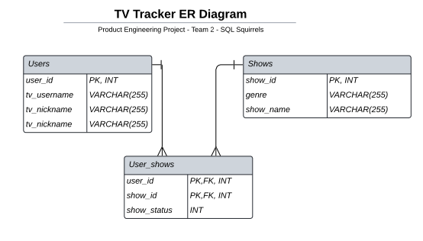
ER Schema

Slide 5
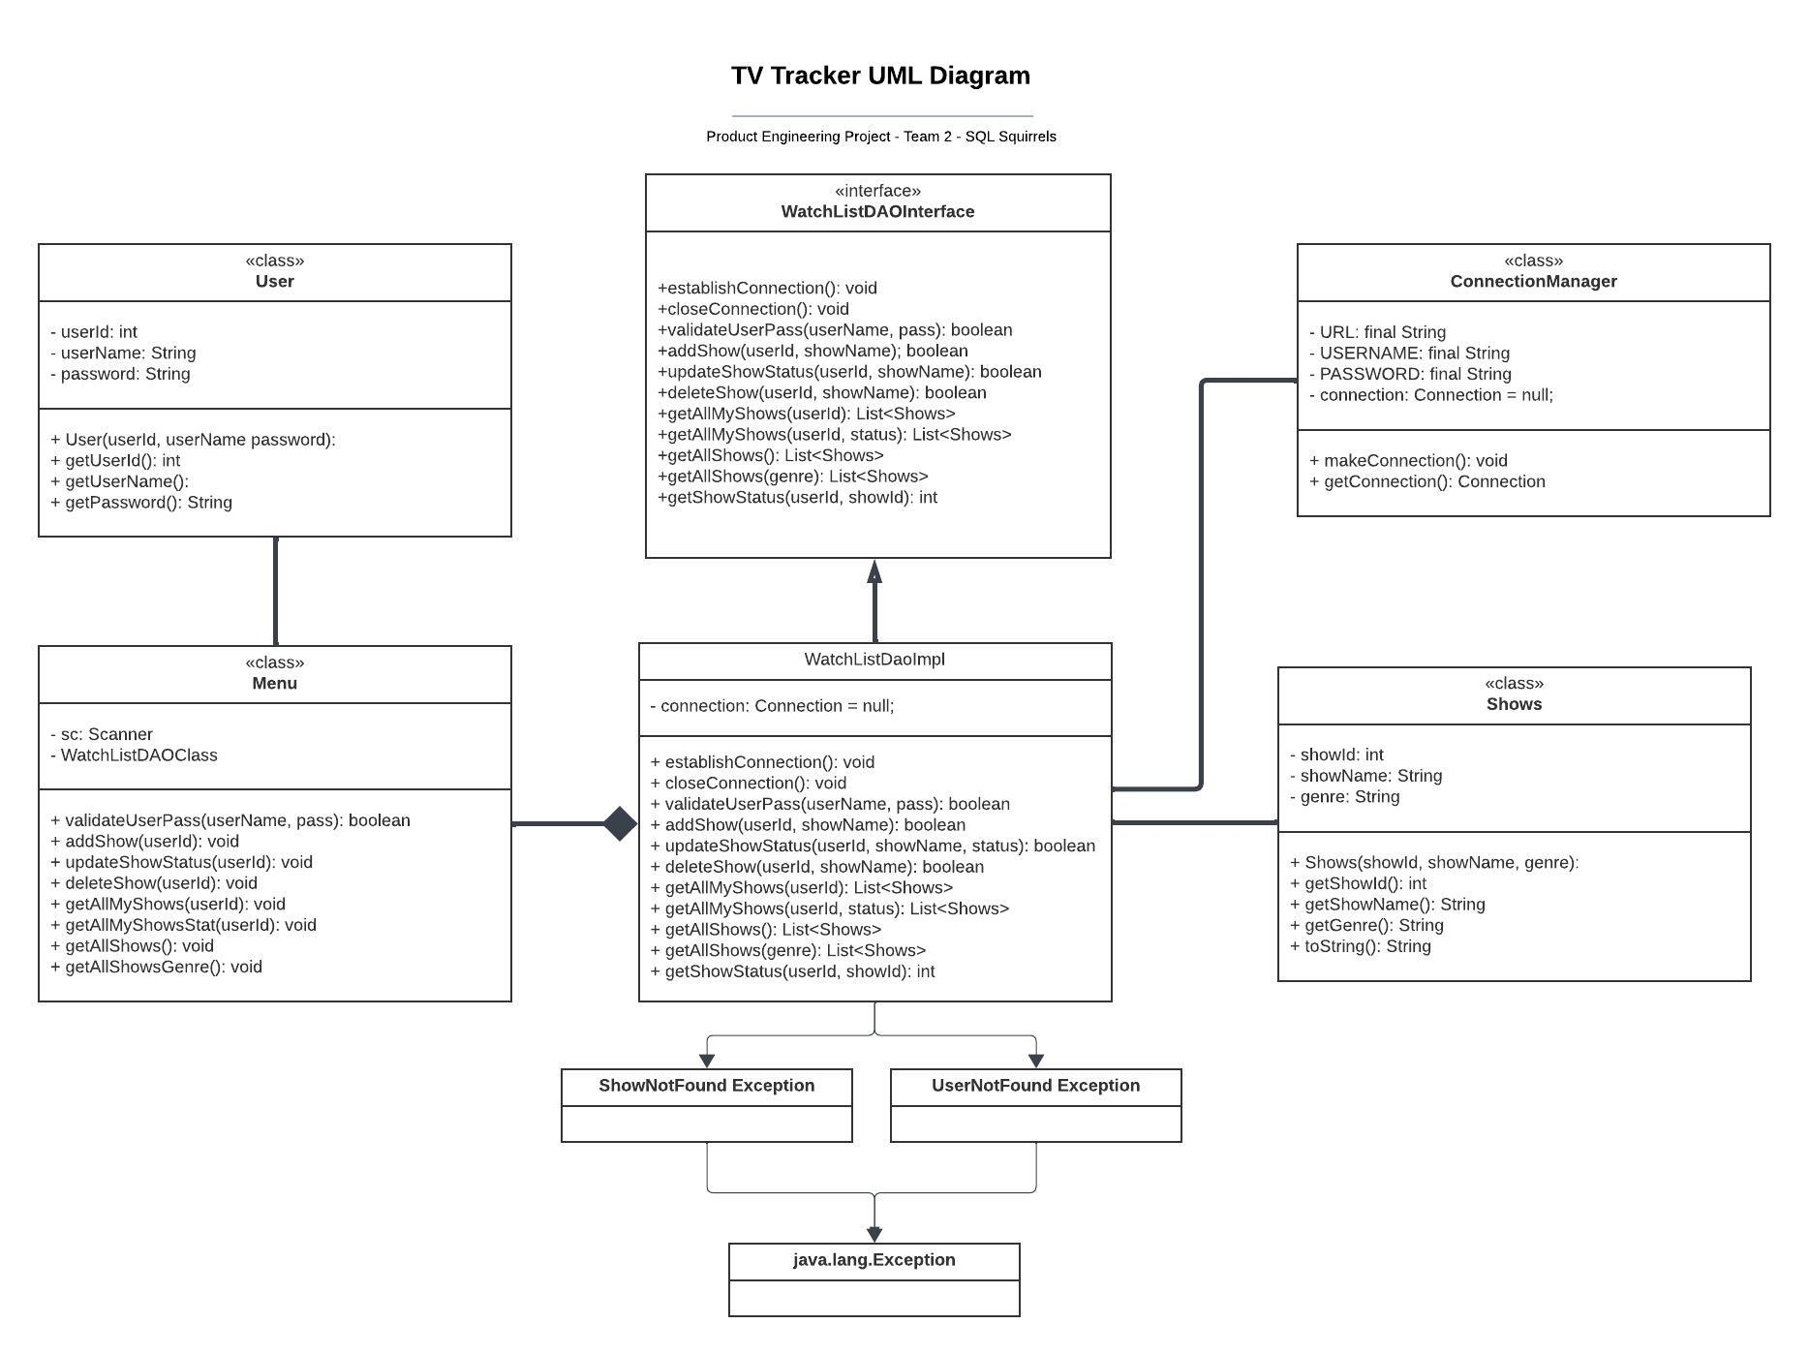
UML Diagram

Slide 6
TV Tracker Demo

Slide 7
What did we learn?
Git/Github – duplicate repository issues, nested repository issues.
Input Validation – several iterations trying to account for all possibilities
ER Schema and UML Diagrams are also iterative.

Slide 8
Sprint Review
MVP was achieved within time constraint while maintaining an amicable and collaborative environment.
Congratulations

Slide 9
Sprint Review – Next Steps
Lance – Adding Administration functionality
Jose – Adding Episode/Percentage progress indication
Brionne – Adding Star Rating functionality

Slide 10
Adding Star Rating Functionality
Add Options to Menu “To rate one of my shows”, “Read reviews for a Show”
Add fields to user_shows table: “ratings”, “review”
Add the average stars to the All Shows listing
List anonymous reviews with associated star rating under the show title (when the menu option is used).

